Slide 1
Game Playing

Slide 2
Generate and Test
Search can be viewed as a generate and test procedures
Testing for a complete path is performed after varying amount of work has been done by the generator
At one extreme the generator generates a complete path which is evaluated
At the other extreme each move is tested by the evaluator as it is proposed by the generator

Slide 3
Improving Search-Based Problem Solving
Two options
Improve “generator” to only generate good moves or paths
Improve “tester” so that good moves recognized early and explored first

Slide 4
Using Generate and Test
Can be used to solve identification problems in small search spaces
Can be thought of as being a depth-first search process with backtracking allowed
Can be used as an expert system for identifying chemical compounds

Slide 5
Dangers
Consider a safe cracker trying to use generate a test to crack a safe with a 3 number combination (00-00-00)
There are 100³ possible combinations
At 3 attempts/minute it would take 16 weeks of 24/7 work to try each combination in a systematic manner

Slide 6
Generator Properties
Complete
  capable of producing all possible solutions
Non-redundant
  don’t propose same solution twice
Informed
  make use of constraints to limit solutions being proposed

Slide 7
Dealing with Adversaries
Games have fascinated computer scientists for many years
Babbage
  playing chess on Analytic Engine
  designed Tic-Tac-Toe machine
Shanon (1950) and Turing (1953)
  described chess playing algorithms
Samuels (1960)
  Built first significant game playing program (checkers)

Slide 8
Why games attracted interest of computer scientists?
Seemed to be a good domain for work on machine intelligence, because they were thought to:
  provide a source of a good structured task in which success or failure is easy to measure
  not require much knowledge (this was later found to be untrue)

Slide 9
Chess
Average branching factor for each position is 35
Each player makes 50 moves in an average game
A complete game has 35¹⁰⁰ potential positions to consider
Straight forward search of this space would not terminate during either players lifetime

Slide 10
Games
Can’t simply use search like in “puzzle” solving since you have an opponent
Need to have both a good generator and an effective tester
Heuristic knowledge will also be helpful to both the generator and tester

Slide 11
Ply
Some writers use the term “ply” to mean a single move by either player
Some insists “ply” is made up of a move and a response
Most common use the first definition, so “ply” is the same as the “depth - 1” of the decision tree rooted at the current game state

Slide 12
Static Evaluation Function
Used by the “tester”
In general it will only be applied to the “leaf” node of the game tree

Slide 13
Static Evaluation Functions
Turing (Chess)
    sum of white values / sum of black values
Samuels (Checkers)
    linear combination with interaction terms
    piece advantage
    capability for advancement
    control of center
    threat of fork
    mobility

Slide 14
Role of Learning
Initially Samuels did not know how to assign the weights to each term of his static evaluation function
Through self-play the weights were adjusted to match the winner’s values
  c1 * piece advan + c2 * advanc + …

Slide 15
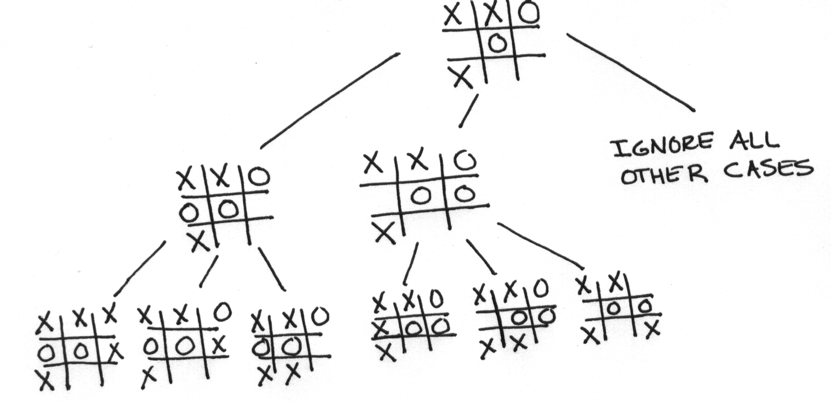
Tic Tac Toe

Slide 16
Tic Tac Toe
100A + 10B + C – (100D + 10E + F)
A = number of lines with 3X’s
B = number of lines with 2X’s
C = number of lines with single X
D = number of lines with 3 O’s
E = number of lines with 2 O’s
F = number of lines with a single O

Slide 17
Example
A = 0 B = 0 C = 1
D = 0 E = 1 F = 1
100 (0) + 10(0) + 1 –
(100 (0) + 10(1) + 1) =
1 – 11 =
-10
X X O
O O
X

Slide 18
Weakness
All static evaluation functions suffer from two weaknesses
  information loss as complete state information mapped to a single number
  Credit Assignment problem
    it is extremely difficult to determine which move in a particular sequence of moves caused a player to win or loss a game (or how much credit to assign to each for end result)

Slide 19
What do we need for games?
Plausible move generator
Good static evaluation functions
Some type of search that takes opponent behavior into account for nontrivial games

Slide 20
1-ply Minimax
A
B
C
D
If the static evaluation is applied to the leaf nodes we get
B = 8 C = 3 D = -2
So best move appears to be B

Slide 21
2-ply Minimax
A
B
C
D
E
F
G
H
I
J
K
Applying the static evaluation function
E = 9 F = -6 G = 0 H = 0 I = -2 J = -4 K = -3

Slide 22
Propagating the Values
Will depend on the level
Assuming that the “minimizer” chooses from the leaf nodes, B would get
B = min(9, -6, 0) = -6
C = min(0, -2) = -2
D = min(-4, -3) = -4
The “maximizer” gets to choose from the minimizers values and selects move C
A = max(-6, -2, -4)

Slide 23
Minimax Algorithm
If (limit of search reached) then
  compute static value of current position
  return the result
Else If (level is minimizing level) then
  use Minimax on children of current position
  report minimum of children’s results
Else
  use Minimax on children of current position
  report maximum of children’s results

Slide 24
Search Limit
Has someone won the game?
Number of ply explored so far
How promising is this path?
How much time is left?
How stable is this configuration?

Slide 25
Criticism of Minimax
Goodness of current position translated to a single number without knowing how the number was forced on us
Suffers from “horizon effect”
  a win or loss might be in the next ply and we would not know it

Slide 26
Minimax with
Alpha-Beta Pruning
Alpha cut-off
  whenever a min node descendant receives a value less than the “alpha” known to the min node’s parent, which will be a max node, the final value of min. node can be set to beta
Beta cut-off
  whenever a max node descendant receives a value greater than “beta” known to the max nodes parent (a min node), the final value of max node can be set to “alpha”

Slide 27
Alpha-Beta Assumptions
Alpha value initially set to -∞ and never decreases
Beta value initially set to +∞ and never increases
Alpha value is always current largest backed up value found by any node successor
Beta value is always current smallest backed up value found by any node successor

Slide 28
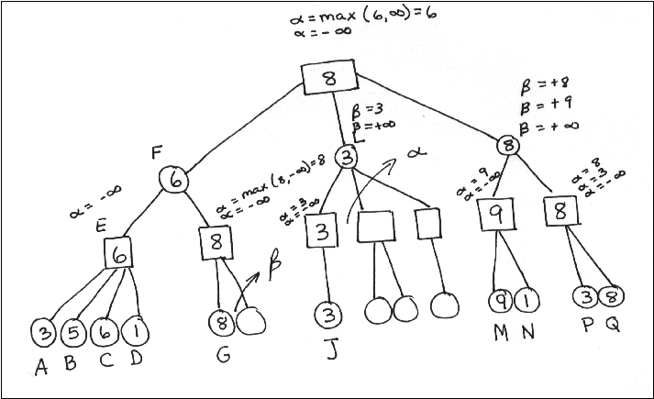
Alpha-Beta Pruning

Slide 29
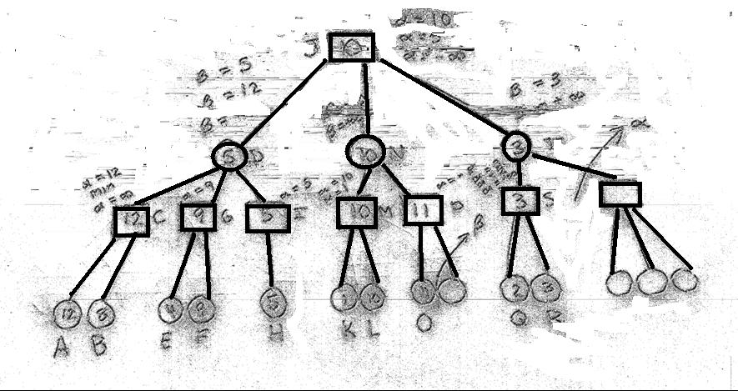
Alpha-Beta Pruning

Slide 30
Alpha-Beta
With perfect ordering more static evaluations are skipped
Even without perfect ordering many evaluations can be skipped
If worst paths are explored first no cutoffs will occur
With perfect ordering alpha-beta lets you exam twice the number of ply that minimax without alpha-beta can examine in the same amount of time

Slide 31
Alpha-Beta Algorithm
Function Value (P, ∝, β)
// P is the position in the data structure
{
// determine successors of P and call them
// P(1), P(2), ... P(d)
if d=0 then
return f(p) // call static evaluation function
// return as value to parent

Slide 32
Alpha-Beta Algorithm
else
{
m = ∝
for i =1 to d do
{
t = - value (Pi - β, - m)
if t > m then
m = t
if => β then
exit loop
}
}
return m
}

Slide 33
Alpha-Beta C++
#include <iostream.h>
#include <time.h>
#include <stdlib.h>
#include <values.h>
// This program is a implementation of the AlphaBeta
const True = 1;
const False = 0;
const MaxNum = 2; //node degree
const NumPly = 4; //search ply
const Root = 1; //start search at this location
const Index = 51;

Slide 34
Alpha-Beta C++
typedef float Tree[Index]; //simulated game tree
typedef int State;
typedef int Ply;
typedef int ListIndex;
typedef float List[MaxNum]; //state siblings
Tree T; //game tree declaration

Slide 35
Alpha-Beta C++
void Init(Tree &T)
// Build dummy game tree.
{
int I;
for (I = 16; I <= 31; I++)
//blank out 4-ply leaf nodes
T[I] = 0.0;
}
float Eval(State S)
//Compute value of state S.
{
return random(101);
}

Slide 36
Alpha-Beta C++
int Terminal(State S)
//Stub function to check S for succesor states.
{
return False;
}
float Max(float X, float Y)
// Returns maximum of X and Y.
{
if (X > Y)
return X;
else
return Y;
}

Slide 37
Alpha-Beta C++
float Min(float X, float Y)
//Returns minimum of X and Y.
{
if (X < Y)
return X;
else
return Y;
}
State Child(State S, ListIndex I)
//Compute I-th successor of state S.
{
return MaxNum * S + I - 1;
}

Slide 38
Alpha-Beta C++
int MachineMove(Ply N)
// Checks to see if it is computer's move
// in this ply.
{
return !(N % 2);
//odd moves are computers
}

Slide 39
Alpha-Beta C++
float AlphaBeta
(State S, Ply N, float Alpha, float Beta)
// Recusively score state S using evaluation
// function Eval and an N - Ply state space graph.
{
State Next;
ListIndex I;
float V, Value, BestScore;
List L; //successors of S at this level

Slide 40
Alpha-Beta C++
if ((N == 0) || Terminal(S))
{
Value = Eval(S);
T[S] = Value; //record values only to confirm cut offs
if (Value > 100) //machine win
return MAXINT;
else if (Value < -100) //machine loss
return -MAXINT;
else if (Value == 0) //draw
return 0;
else
return Value;
}

Slide 41
Alpha-Beta C++
else
{
if (MachineMove(N)) //program's move
BestScore = Alpha;
else
BestScore = Beta;
I = 1;
while (I <= MaxNum)
{
Next = Child(S, I);
V = AlphaBeta(Next, N - 1, Alpha, Beta);

Slide 42
Alpha-Beta C++
if (MachineMove(N)) //program's move
{
BestScore = Max(V, BestScore);
Alpha = BestScore;
if (Alpha >= Beta)
{
BestScore = Beta;
I = MaxNum; //prune remaining S successors
}
}

Slide 43
Alpha-Beta C++
else
{
BestScore = Min(V, BestScore);
Beta = BestScore;
if (Alpha >= Beta)
{
BestScore = Alpha;
I = MaxNum; //prune remaining S successors
}
}
I = I + 1;
}
return BestScore;
}
}

Slide 44
Alpha-Beta C++
void main( )
{
randomize();
Init(T);
cout << "Value = “ <<
AlphaBeta(Child(Root, 1), NumPly - 1, -MAXINT, MAXINT)
<< "\n";
cout << "Value = “ <<
AlphaBeta(Child(Root, 2), NumPly - 1, -MAXINT, MAXINT)
<< "\n";
}

Slide 45
Horizon Heuristics
Progressive deepening
  3 ply search followed by 4 ply, followed by 5 ply, etc. until time runs out
Heuristic pruning
  order moves based on plausibility and eliminate unlikely possibilities
  does not come with “minimax” guarantee
Heuristic continuation
  extend promising or volatile paths 1 or 2 more steps before committing to choice

Slide 46
Horizon Heuristics
Futility cut-off
  stop exploring when improvements are marginal
  does not come with “minimax” guarantee
Secondary search
  once you pick a path using a 6 ply search continue from leaf node with a 3 ply search to confirm pick
Book moves
  eliminates search in specialized situations
  does not come with “minimax” guarantee

